Slide 1
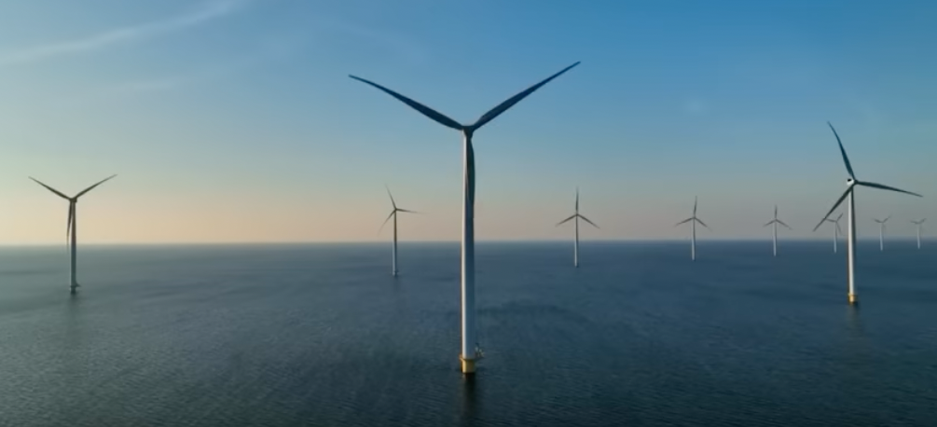
Wind Energy in the United States: Insights from an Investigation of Wind Turbine Data
Kevin Ladisheff, Justin Moreland, Luke Schumaker, Steven Sterkenburg
Instructors: Bill Parker & Kathy Nwe
August 2nd, 2023
Notes:
Analyst from XYZ company
Story
Questions: all of the questions
*State of current
*Document website

Slide 2
Scenario and Questions

Slide 3
Agenda
Current Stats
Historical Trends
Locations
Challenges

Slide 4
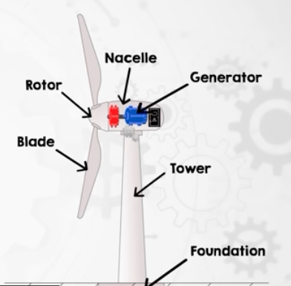
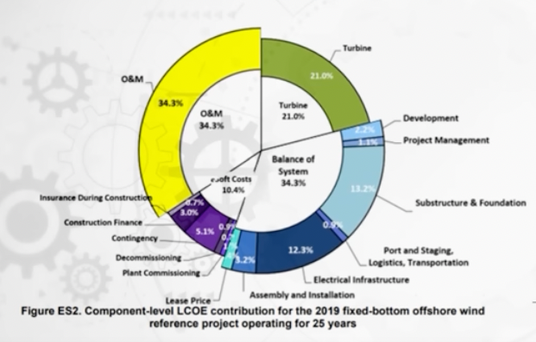
Main Non-turbine Costs
Main Turbine Components

Slide 6
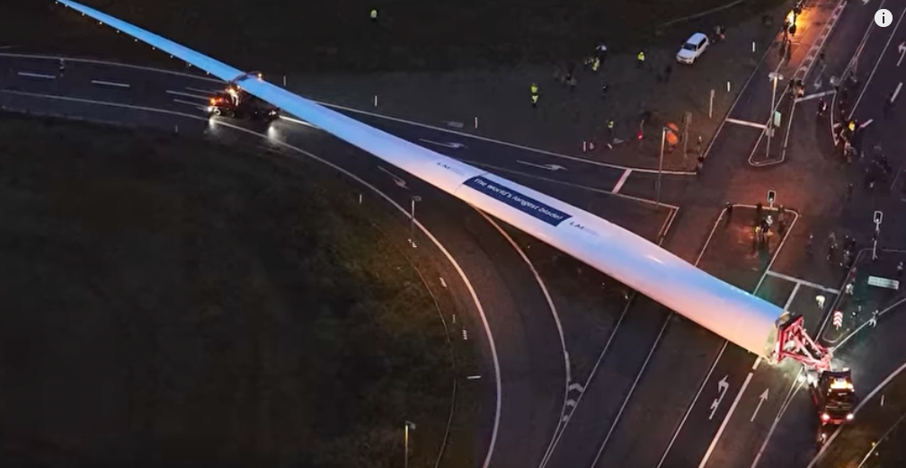
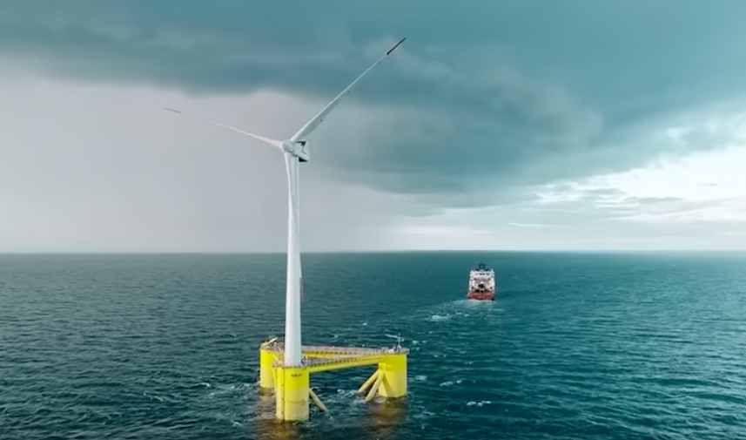
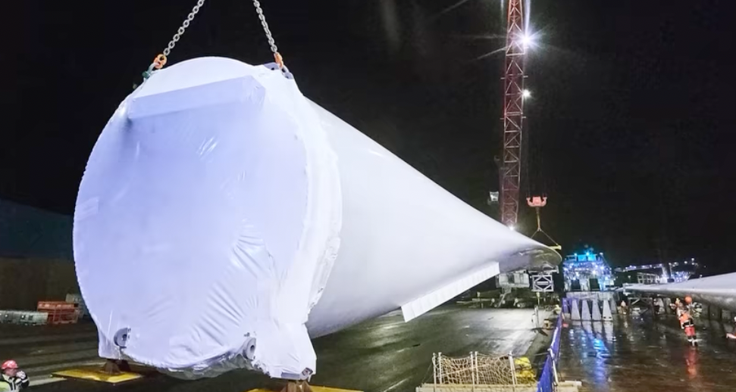

Slide 7

Which size of wind turbines maximizes cost efficiency? A game of Tug-of-War
Team Small:
Structural Design Challenges
Team Big:
*Pretty much everything else. i.e.
Greater Swept Area
Fewer Electrical Connections
Less Maintenance
Simpler to Install

